Slide 1
MILESTONE 4
Reporting & Finalization

Slide 2
Day 1 – Advanced Financial Reports
Objective: Generate detailed financial reports.

Slide 3
Activities
Understand report generation workflow.
Create Monthly Expense Report.
Create Budget Utilization Report.
Generate Investment Performance Report.
Display Financial Goal Progress Report.

Slide 4
Deliverables
Monthly expense report generated.
Budget report created successfully.
Investment report displayed.
Goal progress report completed.

Slide 5
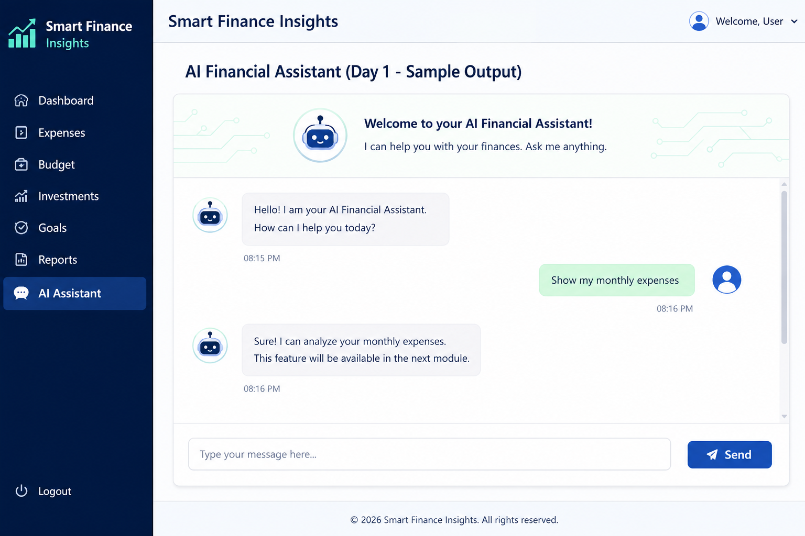

Slide 6
Day 2 – Export Reports (PDF & Excel)
Objective: Export financial reports for users.
Activities
Install PDF and Excel libraries.
Export Expense Report to PDF.
Export Investment Report to Excel.
Download generated reports.
Verify exported files.

Slide 7
Deliverables
PDF export working.
Excel export working.
Reports downloadable.

Slide 8
Day 3 – Dashboard Optimization
Objective: Improve dashboard performance and visualization.
Activities
Optimize SQL queries.
Reduce dashboard loading time.
Improve charts and graphs.
Add summary cards.
Display recent transactions efficiently.

Slide 9
Deliverables
Optimized dashboard.
Faster loading.
Better visualization.

Slide 10
Day 4 – Testing & Debugging
Objective: Test every module.
Activities
Test Login Module.
Test Expense Module.
Test Budget Module.
Test Investment Module.
Test Goal Planning Module.
Fix identified bugs.

Slide 11
Deliverables
All modules tested.
Bugs fixed.
Stable application.

Slide 12
Day 5 – Security Validation
Objective: Improve application security.
Activities
Validate user authentication.
Verify password encryption.
Test role-based access.
Prevent SQL Injection.
Validate user input.
Improve session security.

Slide 13
Deliverables
Authentication verified.
Secure login implemented.
Input validation completed.
Security checks passed.

Slide 14
Day 6 – Deployment
Objective: Deploy the complete application.
Activities
Prepare deployment package.
Configure production database.
Deploy Flask application.
Test deployed application.
Verify all modules online.
Deliverables
Application deployed.
Database connected.
Online testing completed.

Slide 15
Milestone 4 Evaluation Criteria
The milestone is considered complete when:
Advanced financial reports are generated successfully.
Reports can be exported in PDF and Excel formats.
Dashboard performance is optimized.
Application passes testing and security validation.
Complete project is deployed successfully.
End-to-end financial workflow operates correctly.
Project documentation is completed.

Slide 16
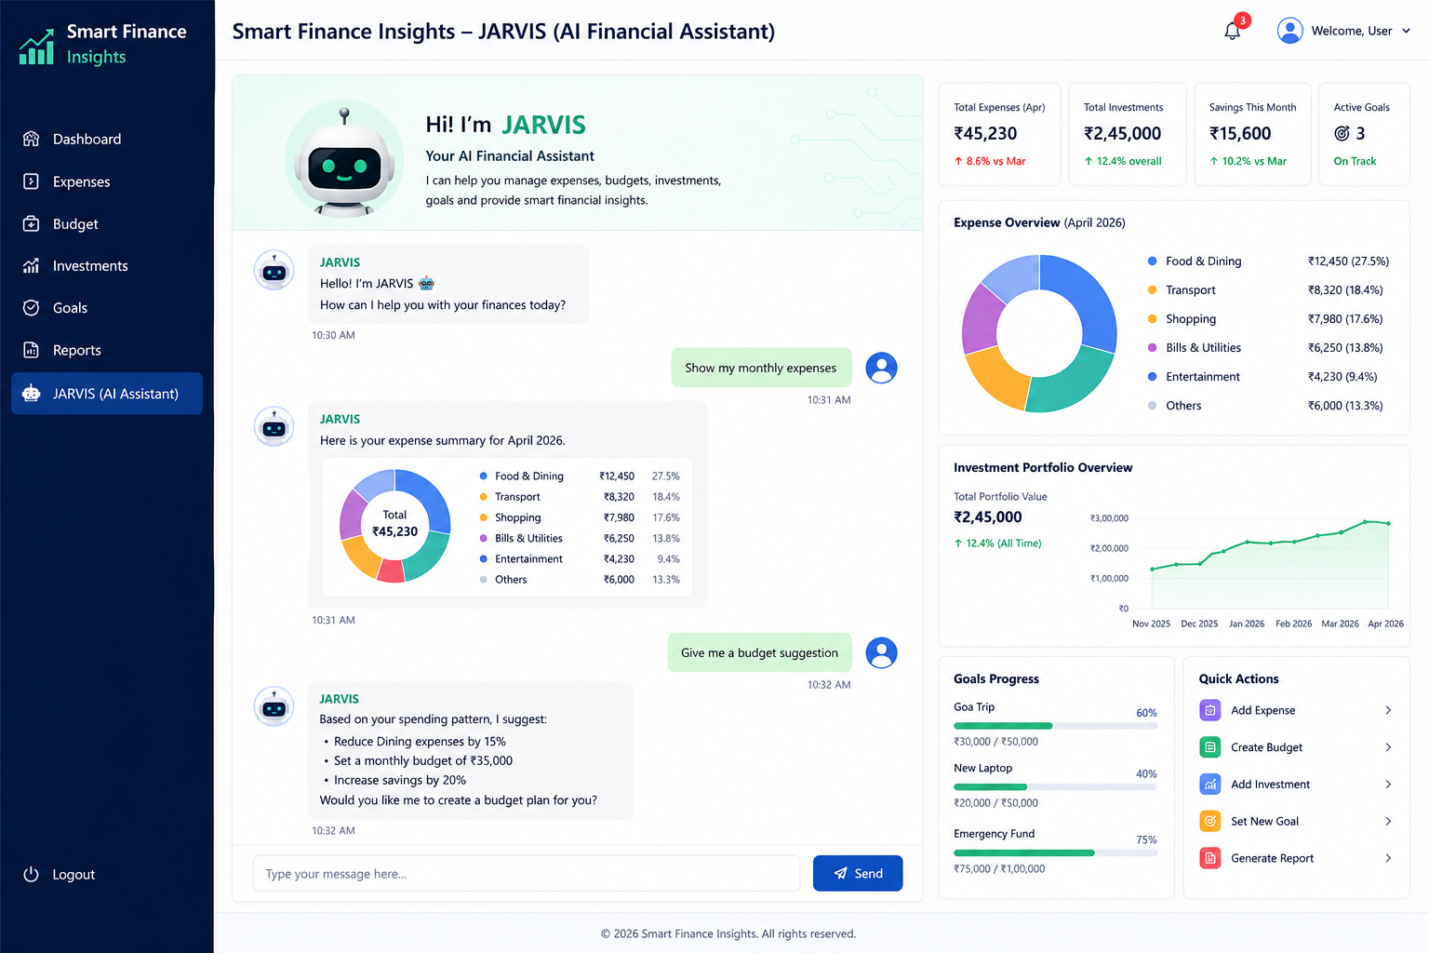

Slide 17
By the end of Milestone 4, students should successfully complete the following deliverables:
✅ AI Financial Assistant (JARVIS) module created.
✅ Interactive chatbot interface developed using Flask.
✅ Users can communicate with JARVIS through natural language.
✅ Expense summary retrieval integrated with JARVIS.
✅ Budget recommendation engine implemented.
✅ Investment portfolio analysis provided through JARVIS.
✅ Financial goal tracking and personalized suggestions integrated.
✅ AI-generated financial insights and recommendations displayed.
✅ Financial summary reports generated successfully.
✅ Conversation history maintained during the session.
✅ Responsive and user-friendly chatbot dashboard designed.
✅ All Smart Finance modules (Expenses, Budget, Investments, Goals, and Reports) integrated with JARVIS.
✅ Input validation and error handling implemented.
✅ Application tested for functionality and performance.
✅ Complete AI Financial Assistant working successfully.

Slide 18
Expected Final Outcome
Students will have developed a fully functional AI-powered Financial Assistant (JARVIS) capable of:
Answering finance-related user queries.
Displaying expense and budget insights.
Providing investment and savings recommendations.
Tracking financial goals.
Generating financial reports.
Delivering personalized financial guidance through an interactive chatbot interface.

